Slide 1
Machine Learning in Medical Imaging

Slide 2
What is Machine Learning?
Field of study that gives computers the ability to learn without being explicitly programmed. (Arthur Samuel, 1959)
A computer program is said to learn from experience E with respect to some task T and some performance P, if its performance on T, as measured by P, improves with experience E. (Tom Mitchell, 1998)

Slide 3

1950 –––– Alan Turing proposed the Turing testing for the machine’s ability to think.¹
1952 –––– Arthur Samuel created the first machine learning programs that play checkers. He later coined the term “machine learning” in 1959.²
1957 –––– Frank Rosenblatt invented the perceptron, with resemblance to a simple biological neuron. It later became the building blocks of future neural networks.³
1989 –––– David Rumelhart, Geoff Hinton and Ronald J. Williams described backpropagation, a core method used in deep neural networks.⁴
1995 –––– Corinna Cortes and Vladimir Vapnik developed support vector machines.⁵
1997 –––– IBM's Deep Blue beats the world champion at chess.
1998 –––– LeCun et al. developed LeNet-5, a pioneering convoluntional network.⁶
2009 –––– ImageNet, a large image database that boomed AI research in the 21st century, was created.
2012 –––– AlexNet by Krizhevsky et.al from Toronto became the first convolutional neural network (CNN) that won the ImageNet competition.⁷
2016 –––– Google’s AlphaGo beat professional human players on GO.
Image source: https://www.amazon.com/Brief-History-Time-Soundtrack/dp/B00TYDKGNU

Slide 4
Types of machine learning
Supervised learning
Classification problem
Binary classification
Multi-class classification
Input and output (label) provided
Machine learns the relationship between the input and the label from the training set and makes predictions on the test set based on that learned relationship.

Slide 5
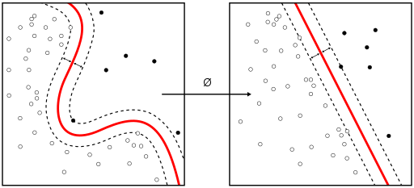
Types of machine learning
Supervised learning
Example algorithms:
Linear Regression
Naïve Bayes Classifier
Decision Trees
Nearest Neighbor
Convolutional Neural Network (CNN)
Image source: https://en.wikipedia.org/wiki/Supervised_learning#/media/File:Kernel_Machine.svg

Slide 6
Types of machine learning
Unsupervised learning
Clustering problem
Only data provided with no labels
Machine learns the underlying structure of data and can group them accordingly, even generate new samples from the same distribution.

Slide 7
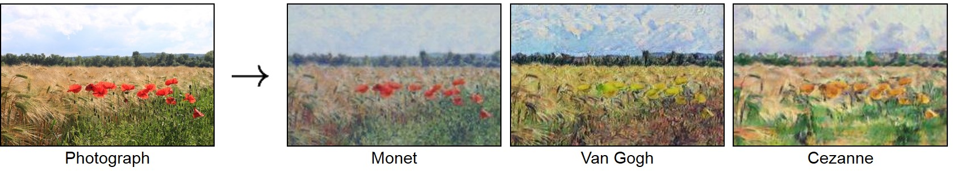
Types of machine learning
Unsupervised learning
Example algorithms:
K-means Clustering
Hierarchical Clustering
Generative Adversarial Networks (GANs)
Image source: https://github.com/junyanz/CycleGAN

Slide 8
Convolutional Neural Network
A class of deep, feed-forward neural network
Consists of multiple layers of “neurons”
Input layer
Hidden layers
Convolutional layer
Activation layer
Pooling layer
Fully connected layer
Loss layer
Output layer

Slide 9
References
Turing AM. 1950. Computing Machinery and Intelligence. Mind. 59(236): 446-447.
McCarthy J, Feigenbaum E. Arthur Samuel: Pioneer in Machine Learning. AI Magazine. 11(3): 10.
Rosenblatt F. 1958. The perceptron: A probabilistic model for information storage and organization in the brain. Psychological Review. 65 (6): 386–408.
Rumelhart D, Hinton G, Williams R. 1986. Learning representations by back-propagating errors. Nature. 323: 533–536.
Cortes, C Vapnik, V. 1995. Support-vector networks. Machine Learning. Kluwer Academic Publishers. 20 (3): 273–297.
LeCun, Yann; Léon Bottou; Yoshua Bengio; Patrick Haffner. 1998. Gradient-based learning applied to document recognition. Proceedings of the IEEE. 86 (11): 2278–2324.
Krizhevsky A, Sutskever I, Hinton G. 2012. ImageNet classification with deep convolutional neural networks. Proceedings of the NIPS. 1: 1097–1105.

